Slide 1
Front End Engineering-I Project
Team Details:
Ketan - 2310992037
Khushi - 2310992038
Khushi - 2310992039
Faculty Coordinator:
Mr. Deepak Kumar
:
Chitkara University Institute of Engineering and Technology,
Chitkara University, Punjab

Slide 2
Table of Contents
Introduction
Fitness Tracker
Technology
Key Features
Project Highlights
Bonus Feature
Conclusion
References/Links used

Slide 3
Introduction
A fitness tracker website serves the purpose of helping users monitor and improve their physical health and well-being. Its primary goals include engaging users, improving their health, ensuring data accuracy, retaining users, protecting privacy and security, and integrating with various devices and apps to enhance the user experience.

Slide 4
Problem Statement
The project aims to solve the problem of fragmented and user-unfriendly fitness tracking tools. It addresses the need for a centralized, user-friendly fitness tracker website by leveraging market research insights and user feedback. The project's goal is to empower individuals to improve their health and fitness more effectively.
The fitness industry has seen a surge in interest, but many individuals struggle to effectively track and manage their fitness goals and progress.
Existing fitness tracker websites often lack user-friendly interfaces and fail to provide comprehensive, personalized insights.

Slide 5
Technical Details
Front-End Technologies:
Utilize modern web technologies such as HTML5, CSS3.
User Interface (UI):
Design an intuitive and user-friendly interface with a focus on user experience.
Social Integration:
Allow users to connect with friends and share their fitness achievements.
Implement social features like comments, likes, and friend invitations.

Slide 6
Key Features
Key features to solve the problem of fragmented fitness tracking include a user-friendly dashboard, goal setting and tracking, data integration with wearables, personalized insights, gamification elements, social interaction, notifications, customizable workouts, nutrition and sleep tracking, data privacy, compatibility, analytics, community support, monetization options, and continuous improvement. These features collectively enhance user engagement and help individuals achieve their fitness goals effectively.

Slide 7
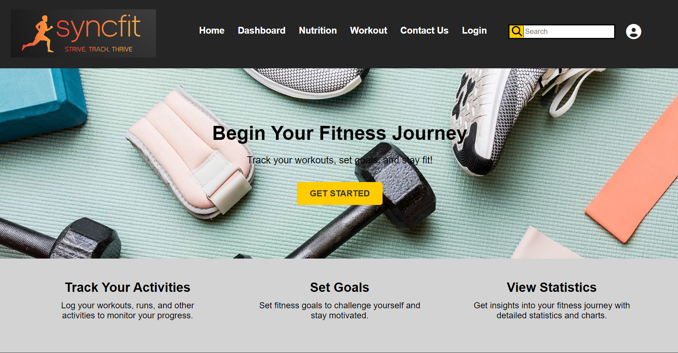
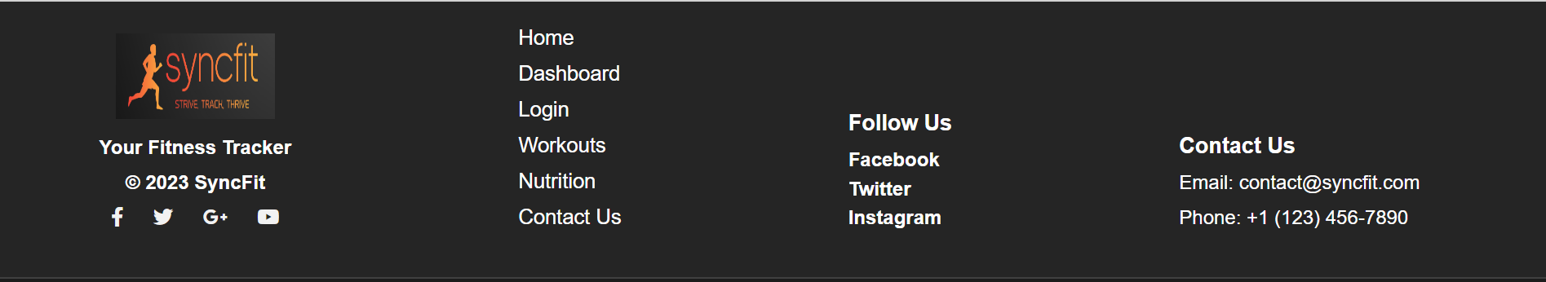
Project Highlights

Slide 8
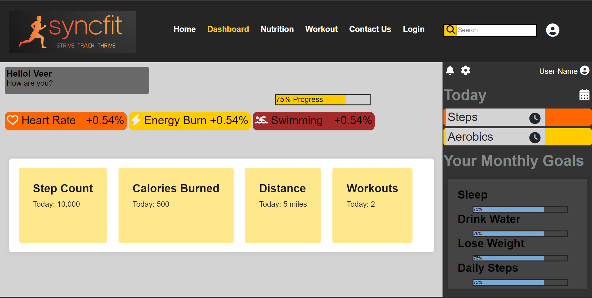


Slide 9

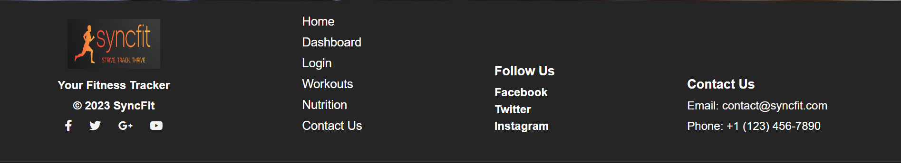

Slide 10
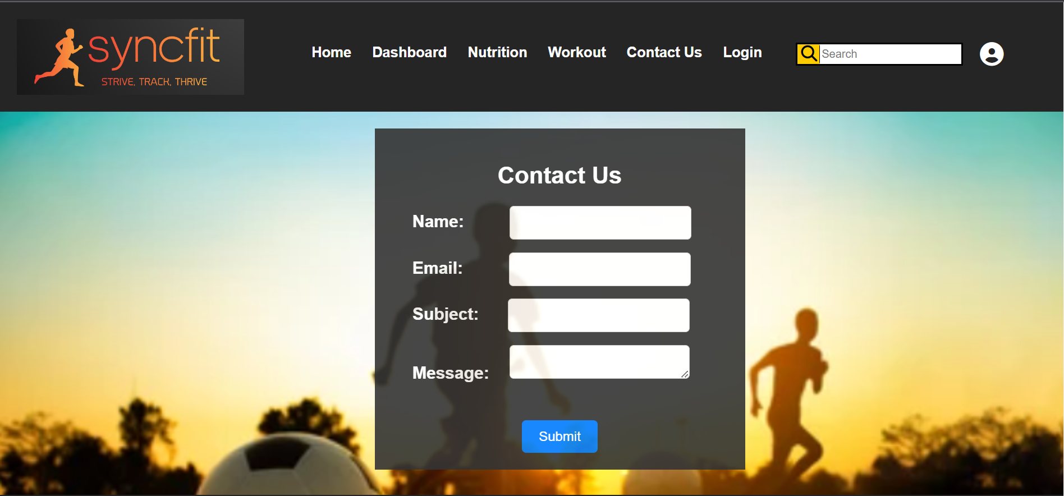


Slide 11
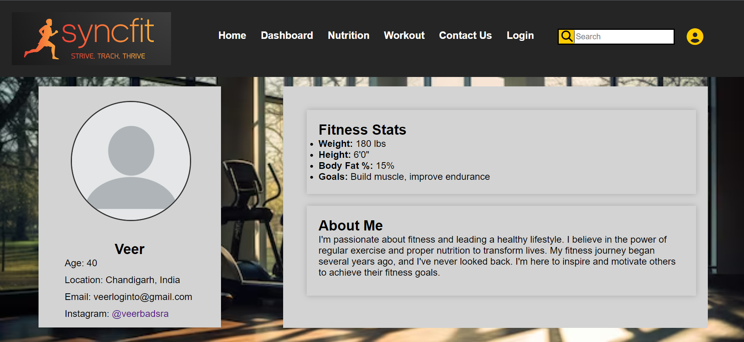


Slide 12
Conclusion
In conclusion, the development of a fitness tracker website with the mentioned key features represents a promising solution to the challenges faced by individuals seeking to monitor and improve their fitness. By creating an accessible, data-driven, and engaging platform, we can empower users to take control of their health, set and achieve fitness goals, and build a supportive community around their wellness journey. As we continue to prioritize data security, user experience, and ongoing improvement, this project has the potential to make a significant impact on promoting healthier lifestyles and well-being.

Slide 13
References/Links used
For icons-https://cdnjs.cloudflare.com/ajax/libs/font-awesome/6.4.0/css/all.min.css
For images – Google images

Slide 14


